Slide 1

SRS FOR
TO-DO-LIST
PROJECT
DONE BY,
PRADEEP S
PERARIVU V
JONE MATHANESH
LOKESH M

Slide 2

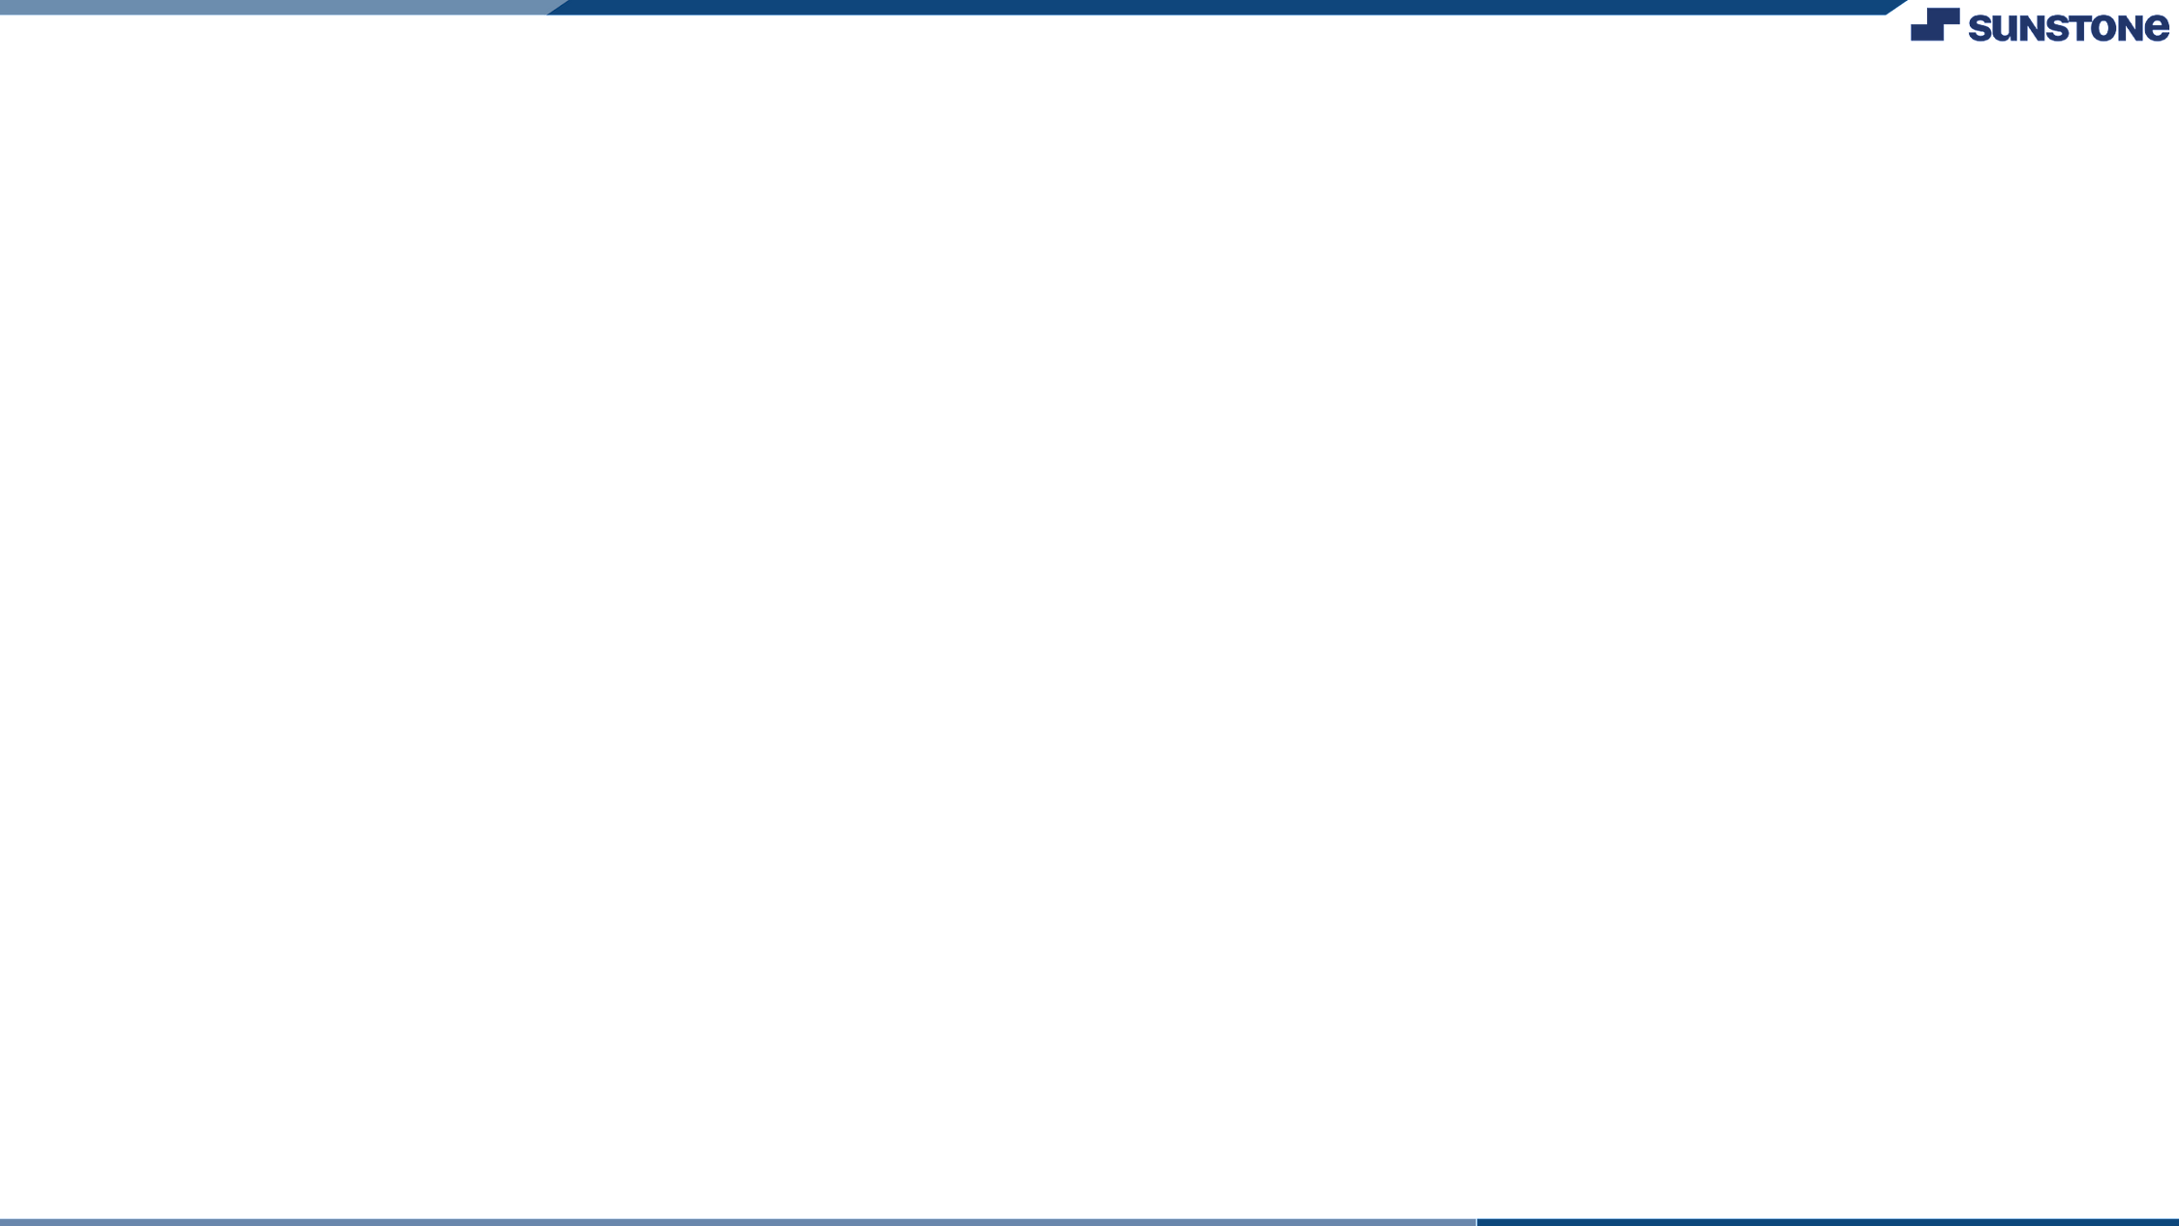


TO-DO-LIST
Introduction:
The To-Do List application is a software system that allows users to manage their tasks and activities in a simple and efficient way. The application will be available for both desktop and mobile platforms.
LMS Username
Name
Batch
2129a3939
2129a3938
2129a3929
2129a3932
Pradeep s
Perarivu v
Jone mathanesh
Lokesh m
A39 A39 A39 A39

Slide 3


Functional Requirements
Task Management
The To-Do List application should allow users to create, edit, and delete tasks. Each task should include the following information:
Task name
Description
Due date
Priority
Project or context
Users should be able to edit and delete tasks at any time.
Reminders
The To-Do List application should allow users to set reminders for tasks. Reminders should include the following information:
Date and time
Notification method (e.g. email, push notification)
Users should be able to edit and delete reminders at any time.

Slide 4

Task Prioritization
The To-Do List application should allow users to prioritize tasks. Prioritization should be based on the following criteria:
Urgency
Importance
Users should be able to change the priority of tasks at any time
Task Categorization
The To-Do List application should allow users to categorize tasks into different projects or contexts. Users should be able to create, edit, and delete projects or contexts at any time.

Slide 5

Task Viewing
The To-Do List application should allow users to view tasks in various ways, including:
By due date
By priority
By project or context
Users should be able to switch between views at any time.
Non-Functional Requirements
Performance
The To-Do List application should be able to handle a large number of tasks and users without slowing down or crashing. The application should also load quickly and respond to user input in a timely manner.

Slide 6
Security
The To-Do List application should be secure. Users should be required to log in with a username and password, and their data should be encrypted in transit and at rest. The application should also include measures to prevent unauthorized access, such as rate limiting and IP blocking.
Reliability
The To-Do List application should be reliable. It should be able to recover from errors and failures without losing user data or compromising security.
Scalability
The To-Do List application should be scalable. It should be able to handle an increasing number of tasks and users without requiring significant changes to the system architecture.

Slide 7
User Interface
The To-Do List application should have a user-friendly interface that is easy to navigate. The interface should be consistent across platforms and devices, and should include the following elements:
Task list
Task creation/editing form
Reminders form
Project/context creation/editing form
Conclusion
The To-Do List application is a software system that allows users to manage their tasks and activities in a simple and efficient way. The system includes features such as task management, reminders, prioritization, categorization, and task viewing. The system also includes non-functional requirements such as performance, security, reliability, and scalability. The user interface is designed to be user-friendly and consistent across platforms and devices.

Slide 8



Submission Github
perarivu.v
https://github.com/Perarivu/to-do-list.git

